Slide 1


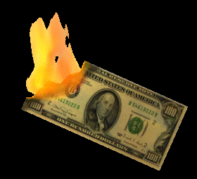
Tobacco Finder
By: Trent Patterson

Slide 3
What it Does?
Finds Tobacco Products!
Keeps Kids Healthy By Finding it.
Discourage Kids From Using it

Slide 4
What is needed to make it?
I don’t know because it will take a lot of time to figure this out

Slide 5
Where it will sell?
It will sell in local retail stores for $1,000
Also it will be sold to schools
Also it will be sold to bussiness

Slide 6
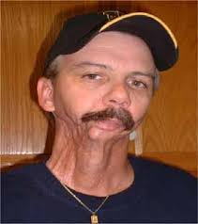
This is What Happens When You Dip

Slide 7

This is What Happens When You Smoke

Slide 8
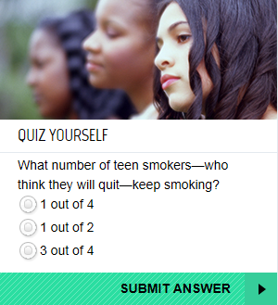

Slide 9
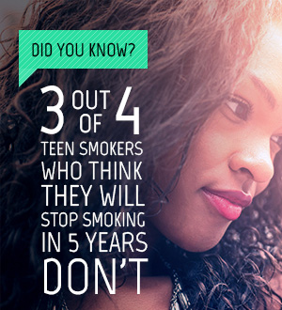

Slide 10
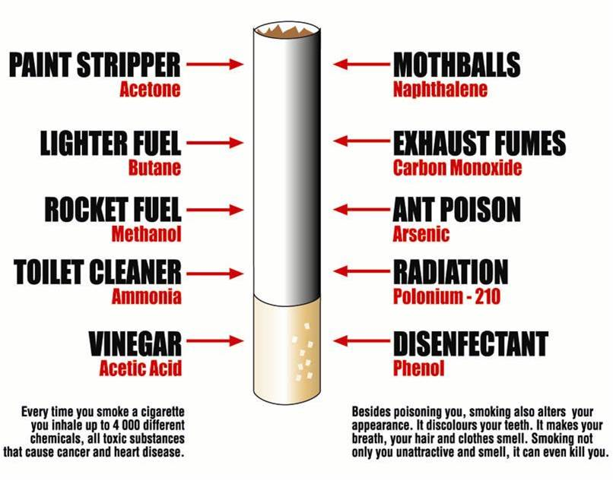
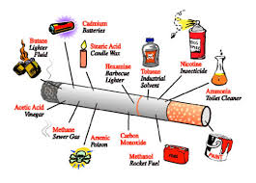

Slide 11

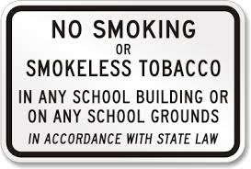

Slide 12
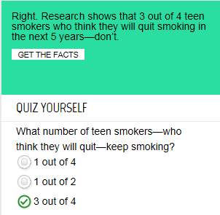
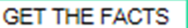
correct

Slide 13
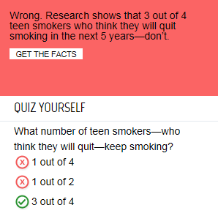
incorrect

